Slide 1

AZURE DEMAND FORECASTING & CAPACITY OPTIMIZATION SYSTEM
Our Team
Frontend
Sirigireddy Chidvilas Reddy
Himanshu
Kavati Shravika Shravika
Backend
Girish Indurkar
Jaya Aswath M E
Ritvik Vashishth
Vaishnavi Katare
Vaishnavi Singh
Yash Bagde
Group Mentor : Kapil Panwar Sir

Slide 2



Problem Faced
Cloud environments today face rapidly changing workloads driven by unpredictable user behavior, business activities, and external events. Organizations operating large-scale cloud infrastructures struggle with:
Sudden and irregular spikes in CPU utilization, storage consumption, and active user count
Under-provisioning, leading to service latency, performance degradation, and potential outages
Over-provisioning, resulting in significant wasted cloud expenditure
Lack of proactive insights into future resource requirements
Difficulty aligning capacity planning with business demand patterns
PROBLEM STATEMENT
Goal
A system that forecasts cloud resource usage, predicts risk, and optimizes capacity to reduce cost and avoid outages.

Slide 3

OBJECTIVES
Our system aims to deliver an intelligent, automated, and highly interpretable forecasting layer that empowers cloud teams to make data-driven decisions:
1
Build accurate predictive models for CPU, storage, and user load across multiple regions
2
Develop a visual dashboard showcasing real-time metrics, historical trends, and forward-looking predictions.
3
Provide capacity optimization recommendations based on demand patterns and risk analysis.
4
Implement an intelligent model selection pipeline that evaluates ARIMA, LightGBM, and LSTM models.
5
Enable REST APIs for smooth integration with operations dashboards and monitoring tool.
6
Automate reporting workflows to support daily, weekly, and monthly forecasting cycles.

Slide 4


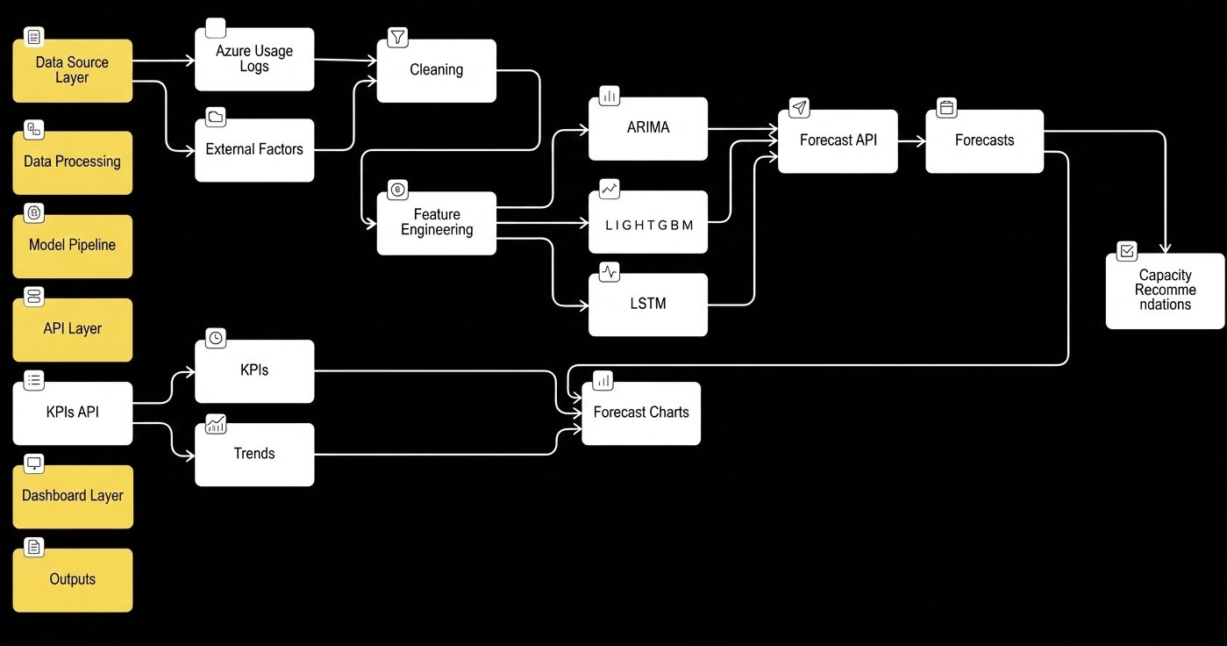
PROJECT ARCHITECTURE
System Architecture Overview:
Data Source → Processing → Model Pipeline → API → Dashboard → Outputs
Forecasting Models : ARIMA , LightGBM , LSTM

Slide 5
TECH STACK
LAYERS
TECHNOLOGIES USED
Frontend
Next.js 14 (React), TypeScript, Tailwind CSS, shadcn/ui, Recharts, Lucide Icons, HTML/CSS, JavaScript
Backend API
Python, Flask, Flask-CORS, Uvicorn
Machine Learning
ARIMA, SARIMA, LightGBM, LSTM (Keras/TensorFlow), Scikit-learn
Data Processing
Pandas, NumPy, Statsmodels
Database/Storage
SQLite (performance logs), CSV/Parquet datasets
Visualization
Recharts (Frontend), Plotly, Matplotlib
DevOps & Tools
GitHub, VS Code, Jupyter Notebook, Azure Cloud Services

Slide 6
MILESTONE OVERVIEW
Data Preparation
Feature Engineering
Model Development
Final Integration
Frontend: Dashboard layout with mock KPIs & graphs
Backend: Cleaned data, prepared CSVs, dummy APIs
Integration: Frontend consumed sample JSON
Frontend: Feature-based graphs & trend visuals
Backend: Enriched datasets, updated APIs
Integration: Dashboard displayed processed data
Frontend: Forecasting view & model selection UI
Backend: ML prediction APIs (/api/forecast)
Integration: Forecast UI connected to backend
Frontend: UI polish, real-time & responsive charts
Backend: Azure deployment, production-ready APIs
Integration: Fully live, end-to-end dashboard

Slide 7
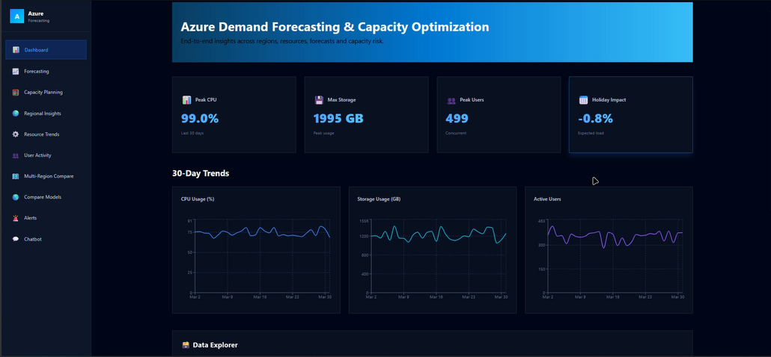
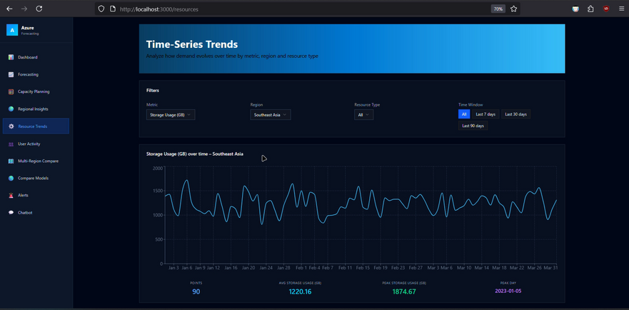
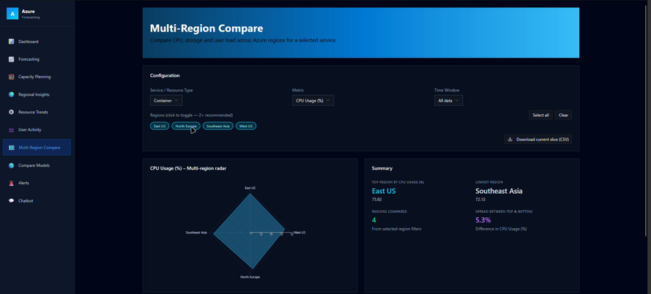
OUR INNOVATIVE SOLUTIONS
1. Overview Page
High-level view of CPU, storage, & user KPIs
Sparkline mini-trends for instant pattern recognition
2. Trends Page
Historical charts with zoom, filter, & region selector
Time-series decompositions & rolling averages
3. Forecasting Page
Actual vs predicted overlay, Model selection
Confidence intervals for predictions
4. Capacity Planner
Risk classification (Low → Normal, Medium → Rising, High → Critical)
Suggested scale-up or optimization action
5. Multi-Region Comparison
Bar charts, radar charts, and heatmaps showing variance
6. Data Explorer
Sorting, searching, filtering through raw or enriched datasets

Slide 8
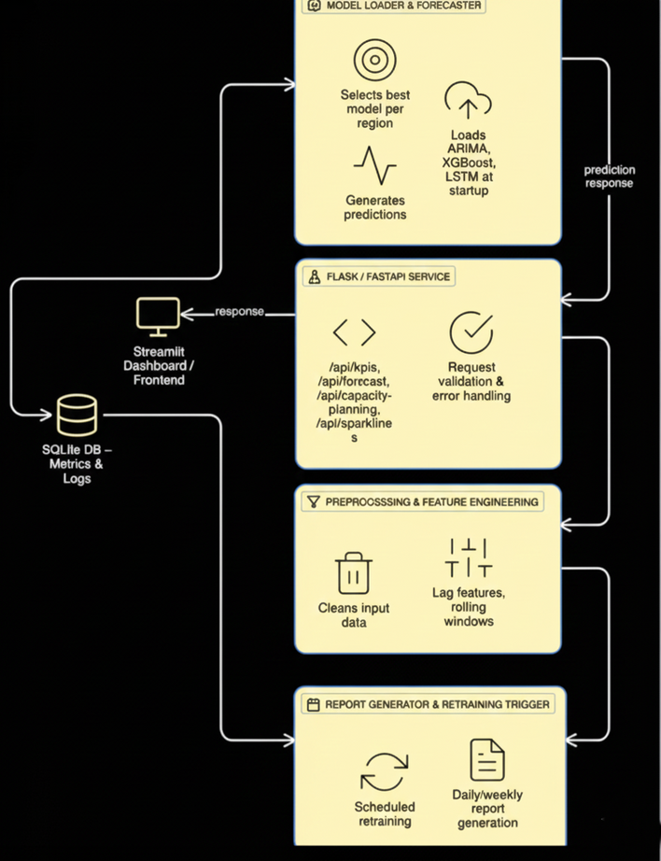
BACKEND ACHITECTURE
API Endpoints
Key Functionalities
/api/kpis → Returns real-time usage metrics
/api/forecast → Predicts resource usage for selected regions
/api/capacity-planning → Provides risk scores and recommendations
/api/sparklines → Mini trend graphs
/api/training/intelligent/trigger → Re-trains models automatically
Loads all trained models into memory at startup for fast inference
Handles high-performance forecasting requests
Computes KPIs like average load, peak hours, utilization patterns
Predicts future risk levels using statistical thresholds
Maintains an SQLite database for storing evaluation metrics
Supports scheduled retraining for continuous improvement

Slide 9
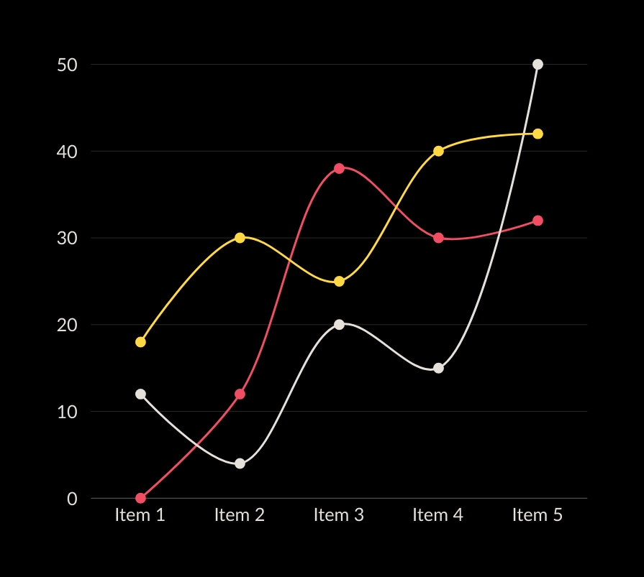
RESULTS & OUTPUT
Model Accuracy (Sample Performance)
CPU Predictions → 80–90% accuracy
Storage Predictions → 70–85% accuracy
User Predictions → 75–88% accuracy
Operational Insights Generated
Peak load hours identified
Regions with inconsistent patterns highlighted
High-demand time windows accurately projected
Visual Outputs
Line charts: Actual vs Predicted
Trend clusters per region
Scatter plots: correlation between metrics
Stacked area charts for pattern visualization
Capacity Optimization
Automated alerts for potential overload
Suggested provisioning level for each region
Cost reduction opportunities identified
Peak load periods accurately identified
Automated capacity optimization for cost savings

Slide 10
CHALLENGES & SOLUTIONS
Challenge
Implemented Solution
Small dataset size | Added lags, rolling means, synthetic seasonal features
Non-stationary behaviour | Applied transformations + advanced LSTM modeling
Model fluctuations | Automated model comparison & selection framework
API integration issues | Introduced CORS, request validation & caching
Varying regional patterns | Trained individualized models per region

Slide 11
FUTURE ENHANCEMENT
Deployment on Azure Kubernetes or Azure App Service
Incorporation of Transformer-based forecasting models
Streaming-based ingestion using Azure Event Hub
Real-time anomaly detection engine
Cost forecasting + ROI impact module
Role-based user authentication for dashboard access
Scaling recommendations integrated with Azure Auto-Scale API
Azure App Service Deployment
Cost forecasting + ROI impact module
Scaling recommendations integrated with Azure Auto-Scale API

Slide 12
THANK YOU
for your time and attention
Github : https://github.com/springboard1233/AZURE_BATCH-4_BACKEND_TEAM_B

